Slide 1
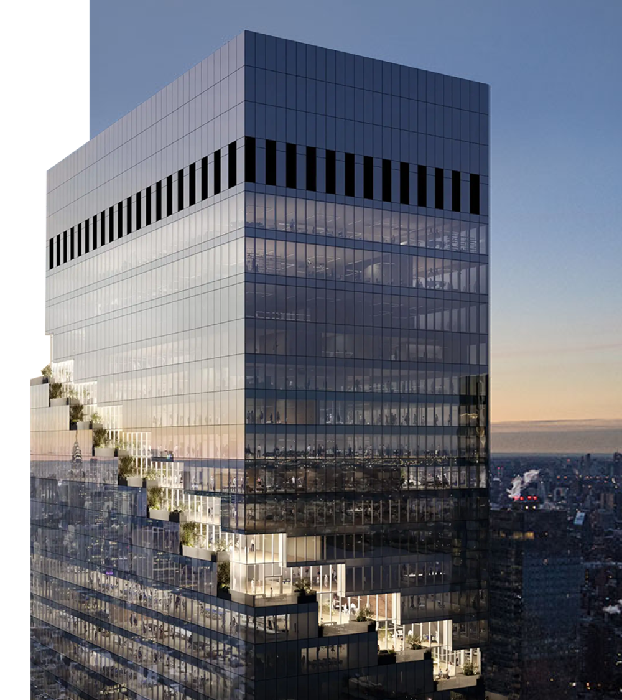
The Role of Travel Behaviors and Attitudes in Shaping Telecommuting Patterns and Productivity
Tassio Magassy¹, Irfan Batur², and Ram Pendyala²
¹WSP USA
²Arizona State University

Slide 2


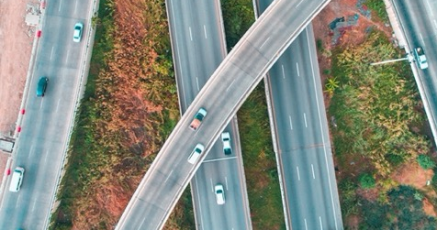
Background
Recent Changes in Work Arrangements
Surge of remote and hybrid work after the pandemic
Permanent or temporary?
Who is telecommuting more?
Impacts on Productivity
Does telecommuting affect productivity?
How to measure productivity changes?
Will employers be more flexible in the future?
Shifts in Travel Behavior
How do attitudes influence perceived productivity and telecommuting frequency?
Will people travel less due to telecommuting more?
How can we include these factors in travel demand models?
WSP | 2025 Modeling Mobility Conference

Slide 3
METHODOLOGY
METHODOLOGY METHODOLOGY
METHODOLOGY
METHODOLOGY
METHODOLOGY
METHODOLOGY
METHODOLOGY
METHODOLOGY
METHODOLOGY
METHODOLOGY
METHODOLOGY
METHODOLOGY
METHODOLOGY
METHODOLOGY
METHODOLOGY
Data | COVID Future Survey – Wave 3
Sample | U.S. adults 18+ with the option to work from home (N=979)
Model | Recursive Ordered Probit Model with Latent Factors
Outcomes | Changes in Perceived Productivity (5-level, ordered: decreased significantly to increased significantly) Telecommuting Frequency (8-level, ordered: 0 to 7 days in the previous week)

Slide 4

DATA

Slide 5




COVID Future Survey
Overview
National online longitudinal survey implemented in Qualtrics
Recruited through online panel, random email address, and convenience sample
Three waves of data collection:
Wave 1 (N = 8,723, April 2020 to October 2020)
Wave 2 (N = 3,093, November 2020 to May 2021)
Wave 3 (N = 2,860, October 2021 to November 2021)
Extensive online survey with over 120 questions
The questions cover a wide variety of subjects including commuting habits, travel choices, work- and study- related questions, shopping, dining, attitudes, activity risk perception… all before, during, and expected after the pandemic
WSP | 2025 Modeling Mobility Conference

Slide 6
Survey Sections
Demographics | age; gender; race; ethnicity; income; household information; access to high-speed internet/mobile phone; and physical disability
Transportation | available vehicles in the household; mode usage frequency; commute to work; air travel before
Work | work status, work from home options, and work productivity
Study | student status and learning characteristics throughout the pandemic
Shopping and Dining Behavior | shopping and dining preferences
Pandemic experience | new ways of living to keep after the pandemic; negative impacts from the pandemic; and COVID-19 testing status
Attitudes | risk perception; socializing preferences; attitudes towards the environment; residential preferences; technology savviness; and views on COVID-19

Slide 7
Study Sample: Workers able to telecommute
2,728
1,253 non-workers
1,475 workers
421: no
1,054: yes
979 responses
Wave 3 valid responses
Workers only
Can the worker telecommute?
Final data cleaning
WSP | 2025 Modeling Mobility Conference

Slide 8
Sample Characteristics
Variable | Category | %
Age Group | 18-29 years | 9.5
 | 30-44 years | 37.5
 | 45-64 years | 44.0
 | 65+ years | 9.0
Gender | Female | 57.5
 | Male | 42.5
Education | Some grade/high school | 0.1
 | Completed high school or GED | 3.2
 | Some college or technical school | 14.3
 | Bachelor's degree(s) or some graduate school | 39.8
 | Completed graduate degree(s) | 42.6
Hispanic | Hispanic | 9.6
 | Not Hispanic | 90.4
White | White | 84.0
 | Not White | 16.0
Variable | Category | %
HH Size | 1 | 18.1
 | 2 | 39.2
 | 3 | 17.5
 | 4 or more | 25.2
HH Vehicles | 0 | 5.0
 | 1 | 36.9
 | 2 | 41.8
 | 3 | 11.3
 | 4 or more | 5.0
HH Income | Less than $35,000 | 6.5
 | $35,000 to $99,999 | 41.8
 | $100,000 or more | 51.7

Slide 9

MODEL STRUCTURE
WSP | 2025 Modeling Mobility Conference

Slide 10
Visual slide with no title
Recursive Ordered Probit Model with Latent Factors
Individual-Level Attributes
Latent Constructs
Main Outcomes
Socio-Demographic
Household Characteristics
Travel Characteristics
Built-environment attributes
Work-related attributes
Social Interaction Propensity
WFH Frequency
(8-level, ordered:
0 to 7 days in prev. week)
Productivity Change
(5-level, ordered: decreased significantly to increased significantly)
Online Activity Inclination
Risk Aversion
Direct Impact
Correlation

Slide 11
Latent Construct Indicators
Social Interaction Propensity | I liked being outside I liked seeing people and having other people around me I enjoy the social interaction found at a conventional workplace
Online Activity Inclination | Online learning is a good alternative to high school and college level classroom instruction Video calling is a good alternative to in person business meetings Learning how to use new technologies is often frustrating
Risk Aversion | If I catch the coronavirus, I am concerned that I will have a severe reaction to the coronavirus if I catch it I am concerned that friends or family members will have a severe reaction to the coronavirus if they catch it. Society is overreacting to the coronavirus

Slide 12


results
WSP | 2025 Modeling Mobility Conference

Slide 13
Main Outcomes

Slide 14
Model Estimation Results
Productivity Change
Telecommute Frequency
Online Activity Inclination
Social Interaction Propensity
Risk Aversion
Online Activity Inclination
18-40 years old
Risk Aversion
Part-time worker
Part-time worker
Worker-student
Education: HS or less
HH Income < $50,000
Vehicles in HH: 3 or more
Low Population Density
HH Income < $50,000
Homeowner
HH Income ≥ $150,000
Commute distance < 5 mi
Commute mode: transit

Slide 15

Takeaways
Attitudes impact travel choices and preferences
More productive individuals WFH more
Vulnerable societal groups tend to WFH less
Risk averse people are less productive and WFH more
WSP | 2025 Modeling Mobility Conference

Slide 16

Next Steps
Ongoing Research
Are there other ways to measure productivity?
Would 2025 data show different results?
What are other latent constructs that could shed extra light on this topic?
How can we use this in travel demand models?
WSP | 2025 Modeling Mobility Conference

Slide 17

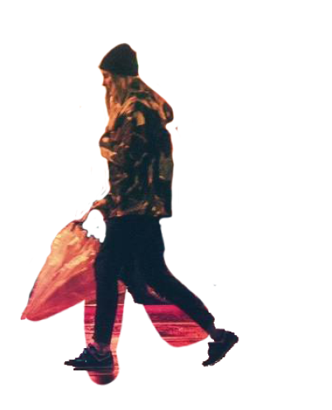
THANK YOU
Tassio Magassy, Ph.D.
^{Tassio.Magassy@wsp.com}
WSP | 2025 Modeling Mobility Conference

